Slide 1
CPU Scheduling

Slide 2
CPU Scheduling Criteria
Throughput: It is the total number of processes completed per unit time or rather say total amount of work done in a unit of time. This may range from 10/second to 1/hour depending on the specific processes.
Turnaround Time: It is the amount of time taken to execute a particular process, i.e. the interval from time of submission of the process to the time of completion of the process (Wall clock time).
Waiting Time: The sum of the periods spent waiting in the ready queue amount of time a process has been waiting in the ready queue to acquire get control on the CPU.

Slide 3
CPU Scheduling Criteria cont…
Load Average: It is the average number of processes residing in the ready queue waiting for their turn to get into the CPU.
Response Time: Amount of time it takes from when a request was submitted until the first response is produced. Remember, it is the time till the first response and not the completion of process execution (final response).
In general CPU utilization and Throughput are maximized and other
factors are reduced for proper optimization.
CPU Utilization: To make out the best use of CPU and not to waste any CPU cycle, CPU would be working most of the time (Ideally 100% of the time).
Considering a real system, CPU usage should range from 40% (lightly loaded) to 90% (heavily loaded).

Slide 4
CPU Scheduling Algorithms
First-Come, First-Served (FCFS) Scheduling
Shortest-Job-Next (SJN) Scheduling
Priority Scheduling
Shortest Remaining Time
Round Robin(RR) Scheduling
Multiple-Level Queues Scheduling

Slide 5
First-Come, First-Served (FCFS) Scheduling
Jobs are executed on first come, first serve basis.
It is a non-preemptive scheduling algorithm.
Easy to understand and implement.
Its implementation is based on FIFO queue.
Poor in performance as average wait time is high.

Slide 6
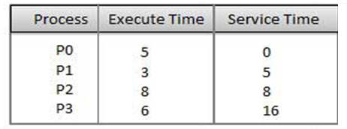
First-Come, First-Served (FCFS) Scheduling

Slide 7
First-Come, First-Served (FCFS) Scheduling

Slide 8
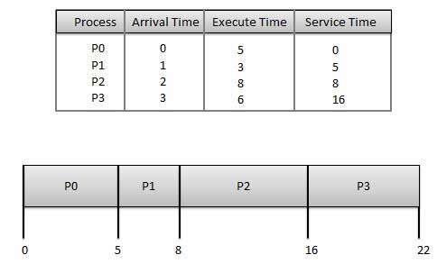
First-Come, First-Served (FCFS) Scheduling

Slide 9
First-Come, First-Served (FCFS) Scheduling
Process | Turnaround Time | Wait Time : Turnaround Time - Burst Time
P0 | 5-0=5 | 5-5=0
P1 | 8-1=7 | 7-3=4
P2 | 16-2=14 | 14-8 = 6
P3 | 22-3=19 | 19 - 6 = 13
Average Wait Time: (0+4+6+13) / 4 = 5.75

Slide 10
FCFS
PROCESS | ARRIVAL TIME | BURST TIME
P1 | 0 | 8
P2 | 1 | 5
P3 | 2 | 2
P4 | 3 | 4

Slide 12
Shortest Job Next (SJN)/Shortest Job First
This is also known as shortest job first, or SJF
This is a non-preemptive, pre-emptive scheduling algorithm.
Best approach to minimize waiting time.
Easy to implement in Batch systems where required CPU time is known in advance.
Impossible to implement in interactive systems where required CPU time is not known

Slide 13
Shortest Job Next (SJN)/Shortest Job First
Process | Execute/Burst Time | Service Time / Response Time
P0 | 5 | 3
P1 | 3 | 0
P2 | 8 | 14
P3 | 6 | 8

Slide 14
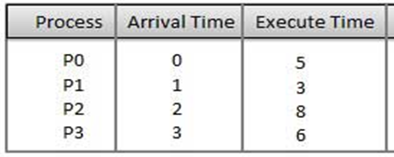

Slide 15
Shortest Job Next (SJN)/Shortest Job First
PROCESS | ARRIVAL TIME | BURST TIME
P1 | 0 | 8
P2 | 1 | 5
P3 | 2 | 2
P4 | 3 | 4

Slide 16
Shortest Remaining Time First
Shortest remaining time First (SRTF) is the preemptive version of the SJF algorithm.
The processor is allocated to the job closest to completion but it can be preempted by a newer ready job with shorter time to completion.
Impossible to implement in interactive systems where required CPU time is not known.
It is often used in batch environments where short jobs need to give preference

Slide 17
Shortest Remaining Time First

Slide 18
Shortest Remaining Time First (SRTF)
PROCESS | ARRIVAL TIME | BURST TIME
P1 | 0 | 8
P2 | 1 | 5
P3 | 2 | 2
P4 | 3 | 4

Slide 19
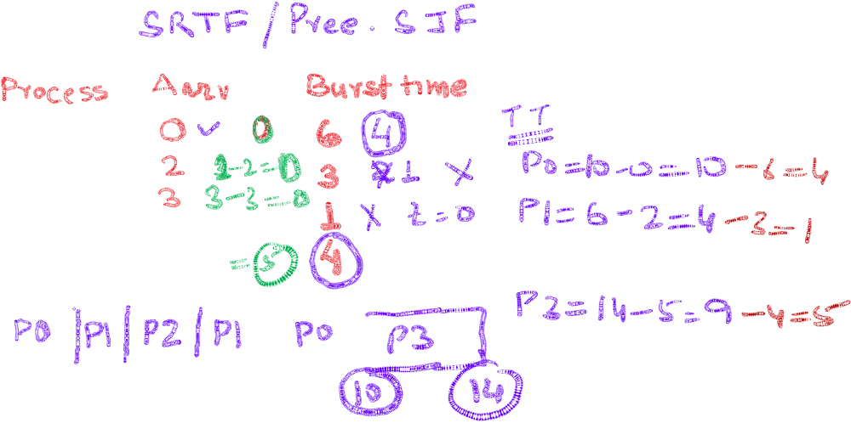



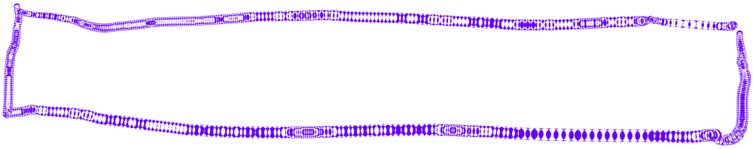


Slide 20









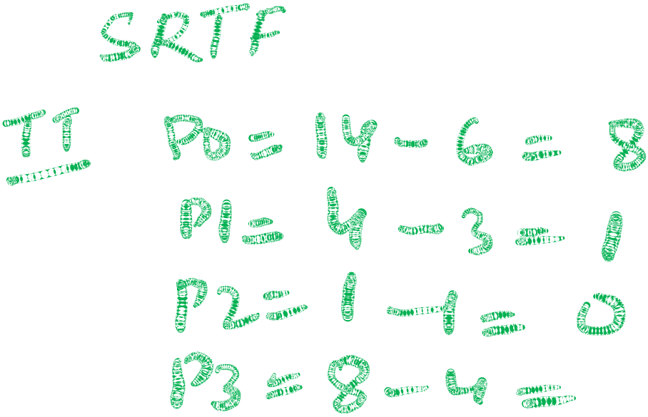


















Slide 21












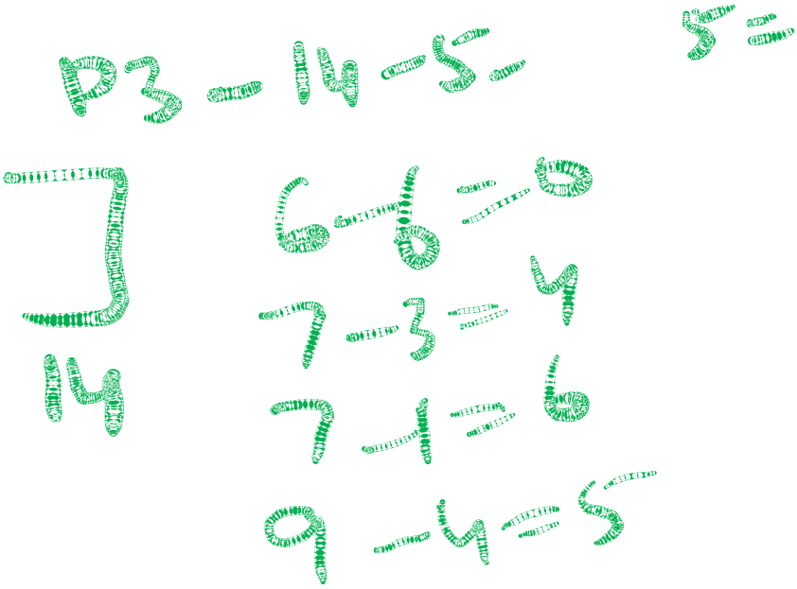












Slide 22
Priority Based Scheduling
Priority scheduling is a non-preemptive / Preemptive CPU Scheduling algorithm and one of the most common scheduling algorithms in batch systems.
Each process is assigned a priority. Process with highest priority is to be executed first and so on.
Processes with same priority are executed on first come first served basis.
Priority can be decided based on memory requirements, time requirements or any other resource requirement.

Slide 23
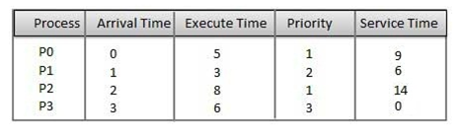

Slide 24







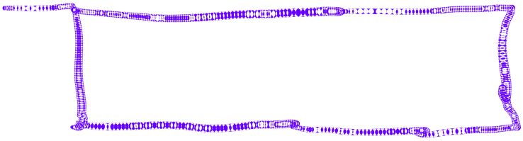







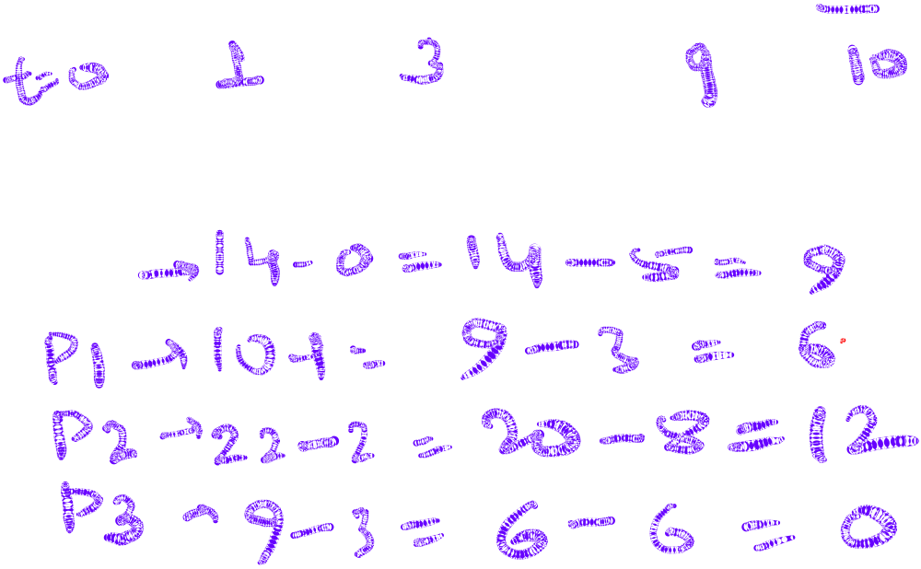



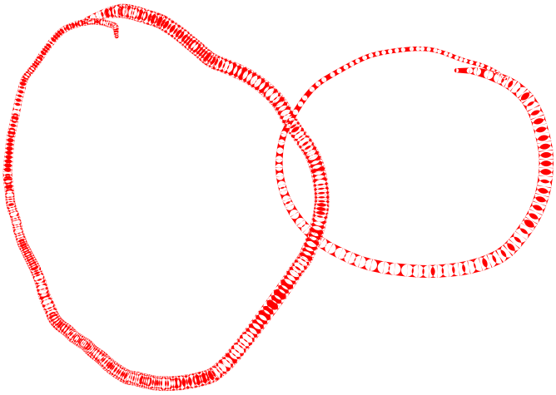




Slide 25





















PROCESS | ARRIVAL TIME | BURST TIME | PRIORITY
P1 | 0 | 8 | 3
P2 | 1 | 5 | 2
P3 | 2 | 2 | 1
P4 | 6 | 4 | 0

Slide 26
PROCESS | ARRIVAL TIME | BURST TIME | PRIORITY
P1 | 0 | 8 | 3
P2 | 1 | 5 | 2
P3 | 2 | 2 | 1
P4 | 6 | 4 | 0

Slide 27
































PROCESS | BURST TIME | PRIORITY
P1 | 8 | 3
P2 | 5 | 2
P3 | 2 | 1
P4 | 4 | 0

Slide 28
PROCESS | BURST TIME | PRIORITY
P1 | 8 | 3
P2 | 5 | 2
P3 | 2 | 1
P4 | 4 | 0

Slide 29
PROCESS | BURST TIME | PRIORITY
P1 | 8 | 3
P2 | 5 | 2
P3 | 2 | 1
P4 | 4 | 0

Slide 30
PROCESS | ARRIVAL TIME | BURST TIME | PRIORITY
P1 | 0 | 8 | 3
P2 | 1 | 5 | 2
P3 | 2 | 2 | 1
P4 | 6 | 4 | 0

Slide 31















Slide 32
Starvation and Aging
Starvation or indefinite blocking is phenomenon associated with the Priority scheduling algorithms, in which a process ready to run for CPU can wait indefinitely because of low priority. In heavily loaded computer system, a steady stream of higher-priority processes can prevent a low-priority process from ever getting the CPU.
Aging : Solution for increasing the time bound priority of processes.

Slide 33
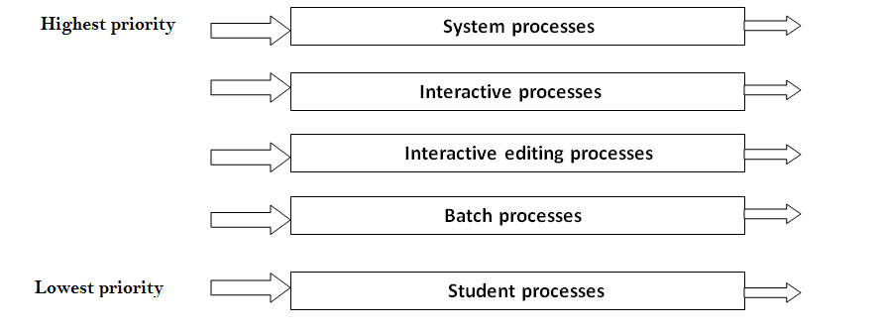
Multiple-Level Queues Scheduling

Slide 34
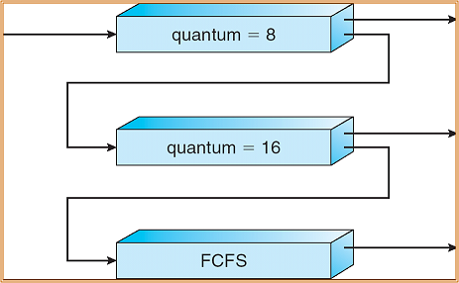
Multilevel Feedback Queues Scheduling

Slide 35
Multilevel Processor Queue scheduling

Slide 36


